Slide 1
OverFlow
Ulises Almaguer Guzmán - A01209070
Topiltzin Hernández Mares - A01703266
Luis Jesús Morales Juárez - A01703455
Carlos Alfonso Sánchez Rosales - A01703280

Slide 2
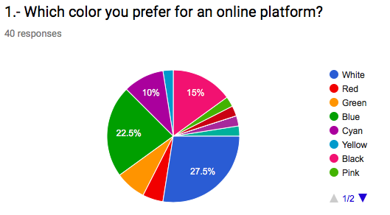
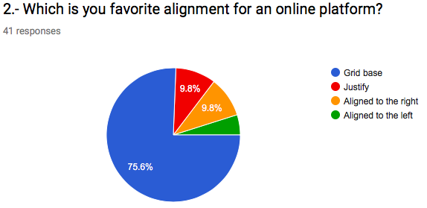
Analysis of the user’s tasks
We did two online surveys, which were intended to get different information about our target audience, the first one was intended to know the user’s preferences about the interface design, while the second one was intended to get the user’s expextation about our platform.
Interface Design Survey:

Slide 3
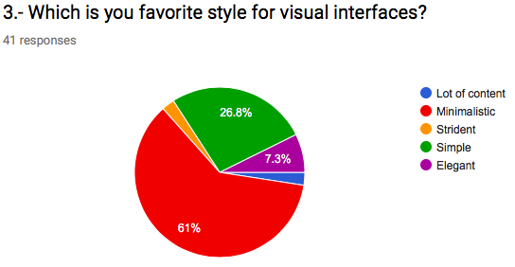
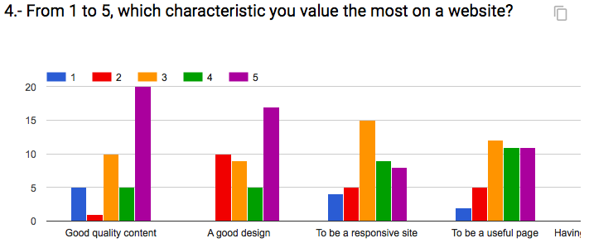
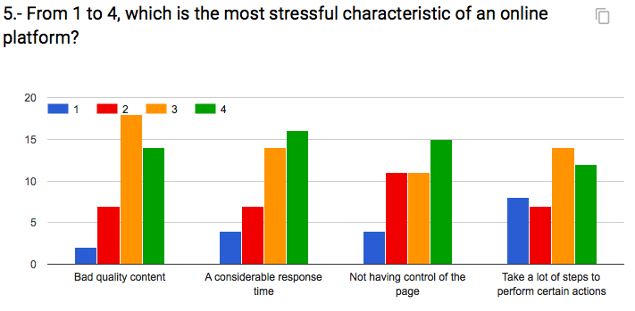
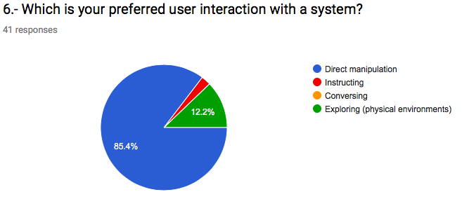
Analysis of the user’s tasks

Slide 4
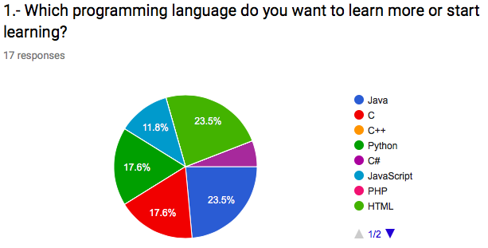
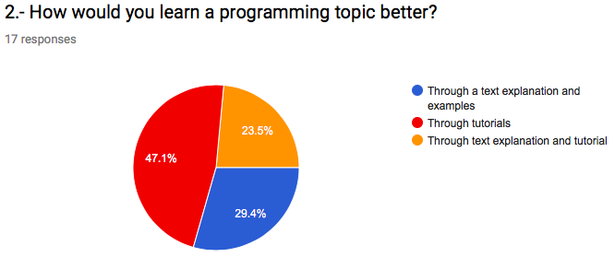
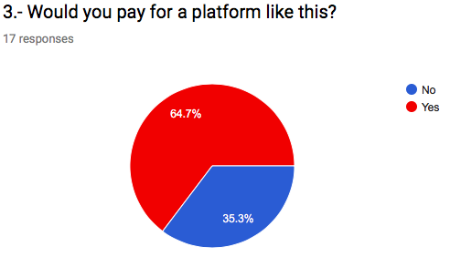
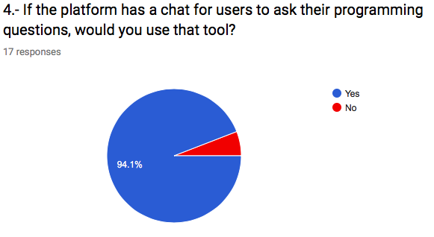
Analysis of the user’s tasks
Overflow Survey:

Slide 5
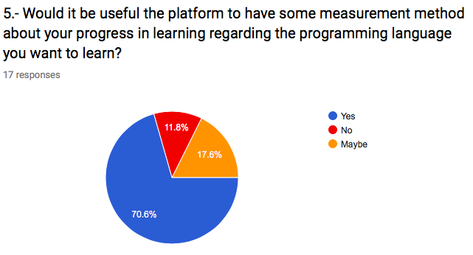
Analysis of the user’s tasks
Overflow Survey:

Slide 6
Prototype design
INFORMATION DESIGN:
We truly believe that the informational design that our application must have is the one that best fits the target user, by that we mean that in order to choose the best information design possible, it is necessary to really get to know out target audience, since that point, and based on the complexity of the information handled on our website, it is possible to choose the best information design.
We consider that the best information structure for the application is a combination of the different structures, this has the purpose of creating a better structural organization of the information that is handled, while it allows the user have a fluid navigation in the application, in such a way that the user can easily find what he is looking for, but at the same time motivating the sense of searching and curiosity to explore new topics.
Having said that, it is possible to said that the information structure that is going to have is a star structure, with a combination of a hierarchical structure.

Slide 7
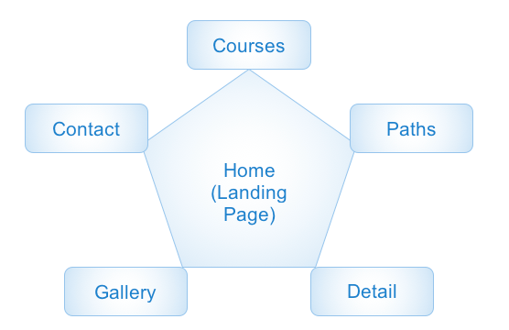
Prototype design
INFORMATION DESIGN:

Slide 8
Prototype design
INTERACTION DESIGN:
The type of interaction that the user must have with the system must be an interaction that promotes curiosity to introduce young users to the world of curiosity and knowledge (in fact, this is one of the goals of the development of this interactive system); however, it must also promote a minimalist interaction to avoid losing the user's attention quickly.
It is possible to say that our interaction style is going to be simple, there will be no necessity for any instructions, the interaction of the user with the platform will be direct manipulation.
The interface; which will be the main way of interaction between the user and the interactive system, will be clean, according to the latest trends of web design. The design philosophy we will use is going to be Google’s Material Design. This way, we can save time in the design in order to make a better functionality of out project.

Slide 9
Prototype design
INTERACTION DESIGN:
The students are going to interact with our system in many forms. There will be a global Navigation bar, with links to all the important parts of the platform (star structure). Images, buttons and links will be available too, these will help to attract the user attention without overloading the user memory with too much colors of figures.

Slide 10
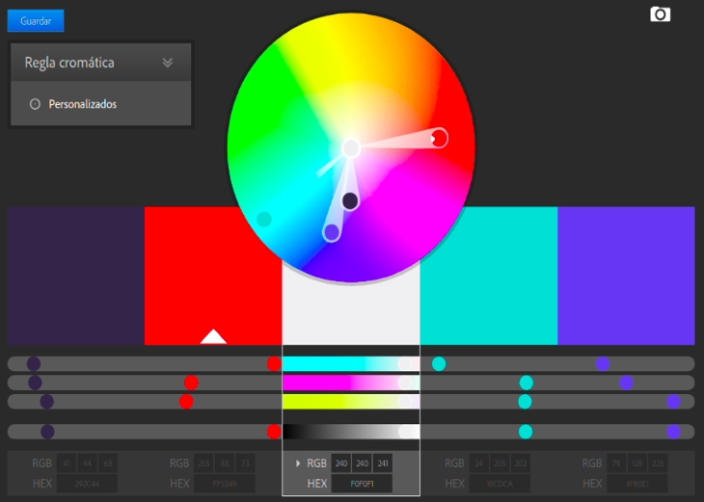
Prototype design
VISUAL DESIGN:
Color synchony: goes according to what was foun in the online surveys; on the ohter hand, the reason why we chose those colors is because according to different studies that have been made in this sector, those colors are the ones that encourage and promote learning.

Slide 11
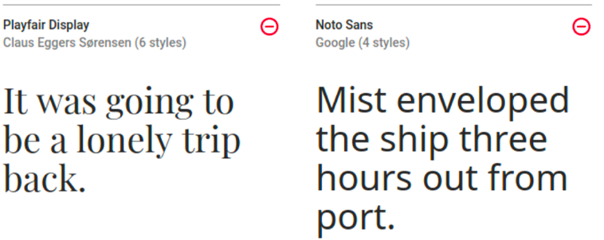
Prototype design
VISUAL DESIGN:
Fonts: This kind of fonts are, currently, very well accepted by the users, because help to keep clean the interface and are very light. Maybe in future, we’ll change this fonts for others with more quality. The main reason why that type of font was chosen is because of its simplicity, it is necessary that the page is easy to read and understand. In other words, it is utilitarian and pragmatic.

Slide 12
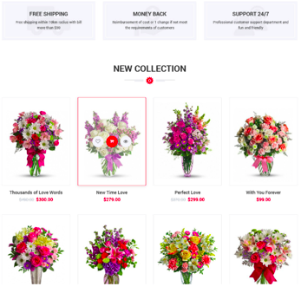
Prototype design
VISUAL DESIGN:
Alignment type: As you can see in the image, the platform will be gird based. The main reason why this type of alignment was chosen is the same as mentioned in the font aspect, the main intention is to maintain a clean graphic interface that is pleasant to the taste, that is utilitarian and pragmatic, easy to understand and to see; in such a way that facilitates and optimizes the search of information

Slide 13
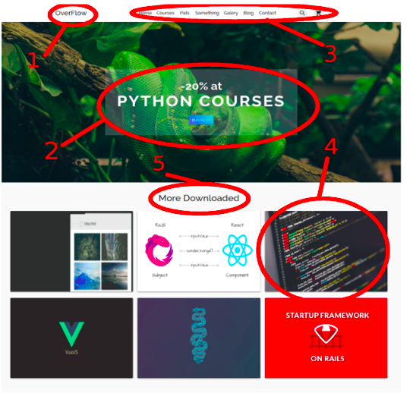
Prototype design
VISUAL DESIGN:
Arrangement of the visual elements: 1) Name and logo; 2) Offers and promos; 3) Menu; 4) Menu; 5) Courses; 5) Titles

Slide 14
Design Principles
STRIVE TO BE CONSISTENT:
It has been decided to have a minimalist design throughout the graphic interface of this interactive system.
The type of alignment that was decided to use, are in accordance with the idea of ​​having a minimalist interface that is simple to use.
The same design format will be used for the buttons, in such a way that the users can quickly distinguish what they are, the same font and color will be used for the titles and the same will happen with the text.
In order to maintain the same design throughout the application, in such a way that it is constant, Google’s Material Design will be used.

Slide 15
Design Principles
UNIVERSAL UNSABILITY:
The application can also be used by newcomers in the use of a computer, as well as beginners in areas related to programming; as well as expertise people in the field.
The user who is using the application will easily know how to distinguish between a button and the various sections that the system interface will present.
It will make use of the previous knowledge that people have about the interaction with other systems, so that users do not have to learn anything ne.
The interactive system in development will have support in various web platforms, such as Google Chrome, Mozilla Firefox and Safari, mainly.
will be a responsive system to the type of platform used and the type of technology (screen size) in which it is being used

Slide 16
Design Principles
PROVIDE FEEDBACK:
Talking a bit about the feedback that the user will receive when takes an online course, is that through the activities, lessons, videos, etc. An assistant can help them. At this point we can use what we call virtual agents.
DESIGN A DIALOGUE LEADING TO AN END:
We decided to make an easy way to move the users from selecting courses to the checkout, the checkout page will be completely clearly, this means to break down all the products and at the end show to the user the mount to pay, to ending, we decide to conclude with a clear confirmation page that completes the transaction and send to the user a confirmation email too.

Slide 17
Design Principles
IT IS BETTER TO PREVENT ERRORS:
The developing system is characterized by being a closed information system, in fact, it will have within itself a large number of limitations that will limit the possible errors that can be made when navigating and using the interactive system.
ALLOW UNDO:
In every form in the page we will put a “Clear” button, a lot of times is easier press a button as delete all the textbox, furthermore, in the checkout page, we will put visible “X” buttons beside the products to facilitate the user quit wrong products.

Slide 18
Design Principles
GIVE CONTROL TO THE USER:
The user will have total control of what happens to the time of execution of the interactive system, in fact, the user is responsible for what happens or not within the system, so, if the user wants to be redirected to a certain page to be able to review its content or wants to send a specific form, it is the user who must give the order for certain action to pass, for this, it is necessary that the user click on the option of his preference.
AVOID OVERLOADING THE USER’S MEMORY:
The interaction with the system, as previously mentioned, will be extremely simple and intuitive, the user will know how to interact with the system just by looking at the way in which the various elements of the interface are displayed on screen.
It will make use of the previous knowledge that people have about the interaction with other systems, so that users do not have to learn anything new.

Slide 19
EMOTIONAL ASPECTS
POSITIVE EMOTIONS:
To achive positive emotions the interface of our application will show balance and consistency throughout the page in aspects such as colors, fonts and distribution of spaces within the interface.
This site will use the typography "Playfair" and "Noto Sans", since this type of font will allow maintaining a clean and light interface, in such a way that it will be in good taste for the users.
The forms that will be used in the graphic interface are rectangular shapes, which denote cleanliness and functionality, give order and a good appearance to the page; these forms transmit to the user the sensation of being in a functional application

Slide 20
EMOTIONAL ASPECTS
FRUSTRATION (HOW TO AVOID IT):
It is very important that the control over what happens in the application is given to the user, in this way, the site will respond to the actions that the user wants.
The site will be responsible for providing the necessary information that the user needs, so the error can be solved in the most effective way possible.
The interface that will be displayed will be minimalist, practical and utilitarian, where it is possible to find what the user wants, but at the same time motivates curiosity.
We will look for ways to simplify the number of steps to carry out the various actions on the site, so that it is the minimum possible number before stressing the user.

Slide 21
EMOTIONAL ASPECTS
PERSUASIVE TECHNOLOGIES:
The "persuasive technology" implemented will be through the design that the site will have. The site allows to find the information that the user wants in a quick way, but at the same time allows to develop in those who use the platform a spark of curiosity and the need to learn new topics.
ANTHROPORMORPHISM:
We believe that we can include this aspect in a very subtle way, through discussion forum among the different users of the application, so that they can have a "real interaction” (computer interaction) with other users interested in programming topics.

Slide 22
EMOTIONAL ASPECTS
VIRTUAL AGENTS:
Due to the nature of the project, achieving the implementation of a virtual agent could be very complicated and might not be very useful.
The way in which virtual agents would be implemented in the page, would be through chats, in which the user would choose; if the user wants to make a feedback, the system allows it.
Another way in which it is possible to implement them is through a virtual tab in which you can ask questions about the operation or content of the system; however, this functionality is somewhat complex, so it is possible that this is lacking from the final implementation

Slide 23
References
Alonso. (2012). 10 Ventajas de las encuestas online. March 31, 2018. From netquest.com Website: https://www.netquest.com/blog/es/blog/es/10-ventajas-de-las-encuestas-online
Borgen. (2017). How to make your HTML responsive by adding a single line of CSS. March 31, 2018. From FreeCodeCamp Website: https://medium.freecodecamp.org/how-to-make-your-html-responsive-by-adding-a-single-line-of-css-2a62de81e431
Caden. (2017). Agentes virtuales que reemplazan humanos. March 31, 2018. From caden.com.mx Website: http://www.caden.com.mx/es/agentes-virtuales-que-reemplazan-humanos/
Cs.umd.edu. (2018). The Eight Golden Rules of Interface Design. [online] Available at: https://www.cs.umd.edu/users/ben/goldenrules.html [Accessed 1 Apr. 2018].
González, A. (2012). El ojo sobre tu web. ¿Lo sabías?, pues así la ven. feb, 11, 2018, de El Economista Sitio web: https://infoautonomos.eleconomista.es/blog/el-ojo-sobre-tu-web-lo-sabias-pues-asi-la-ven/
Universa. (2017). Qué colores facilitan el estudio. March 31, 2018. From Universa España Website: http://noticias.universia.es/cultura/noticia/2017/04/17/1151485/colores-facilitan-estudio.html#

